Slide 1

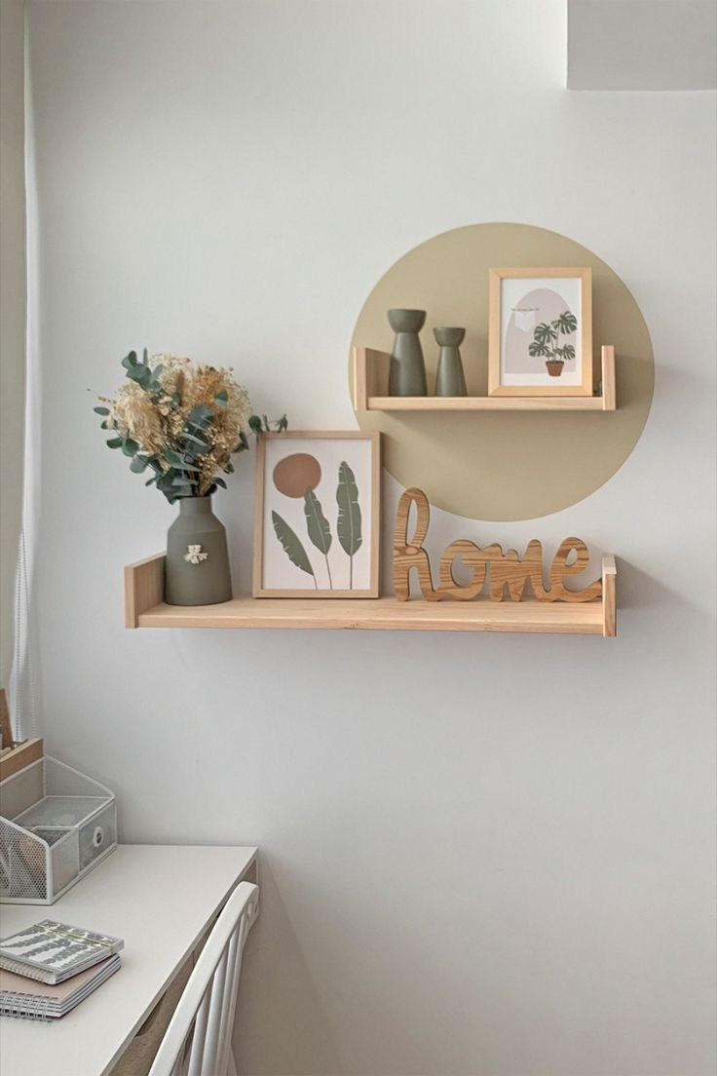
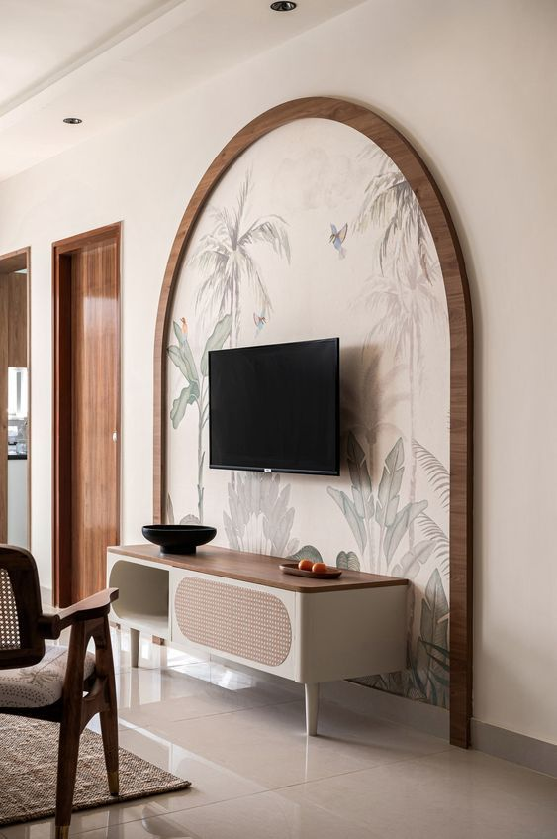
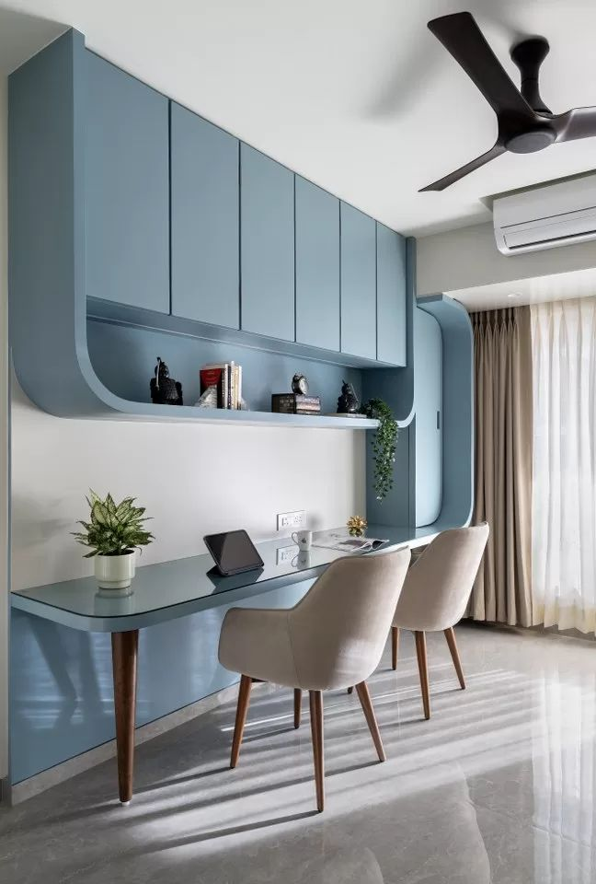
COMPANY PROFILE
The Perfect choice for Modular furniture (Kitchen ! Wardrobe), Hardware & Interior.

Slide 2
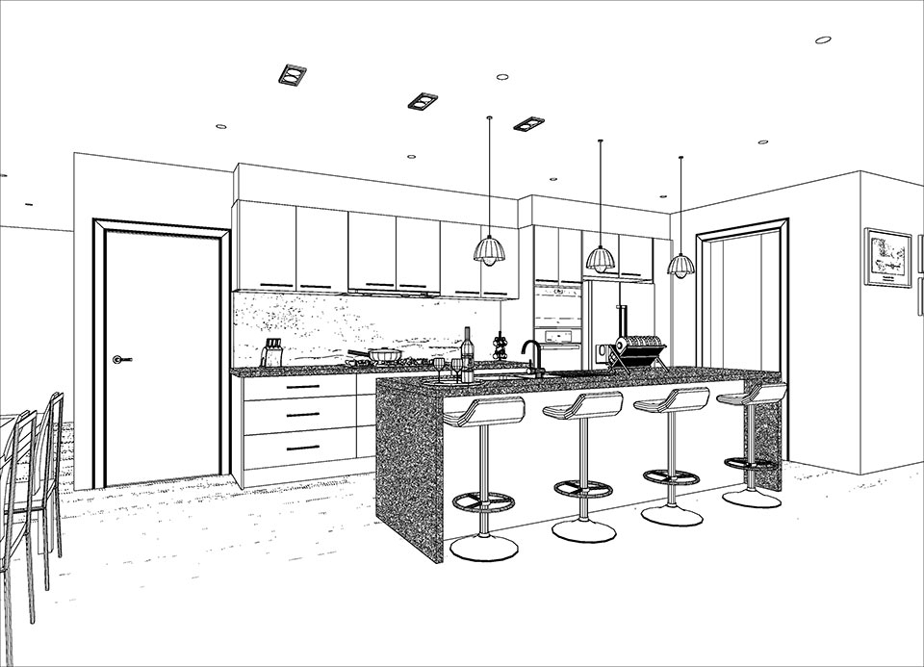
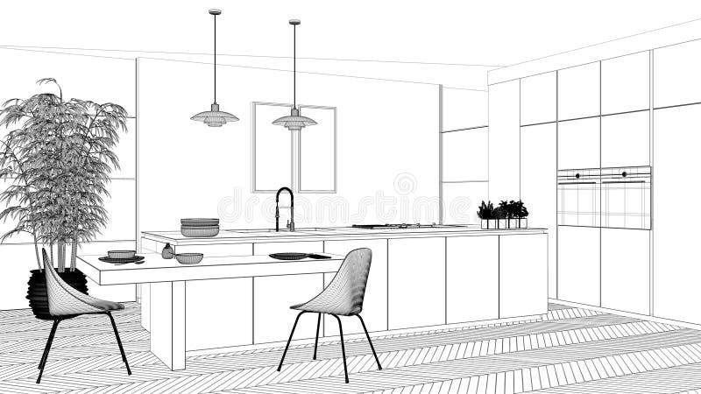
“Ready to Turn your Home to Dream House “
At Houzz Mood, our core belief revolves around reshaping environments through inventive modular furniture and interior solutions. Whether you're seeking a makeover for your living room, office, or any other area, our range of adaptable and multifaceted designs promises to enhance your experience in unprecedented ways. Your space will undergo a transformation like never before, thanks to our commitment to delivering personalized and flexible solutions that cater to your unique needs and preferences.
Houzz Mood
Selective :- Customized home solutions tailored to fit your needs. With our modular kitchen, modular wardrobes, and a wide range of customizable modular furniture options.
Houzz Mood
Elite :- Where we bring you a complete home interior solution like no other. From concept to creation, we offer a seamless journey to transform your living space into a masterpiece.
Houzz Mood
Commercial :- Commercial is one stop destination for complete and customized modular furniture and interior solutions for commercial spaces.

Slide 3
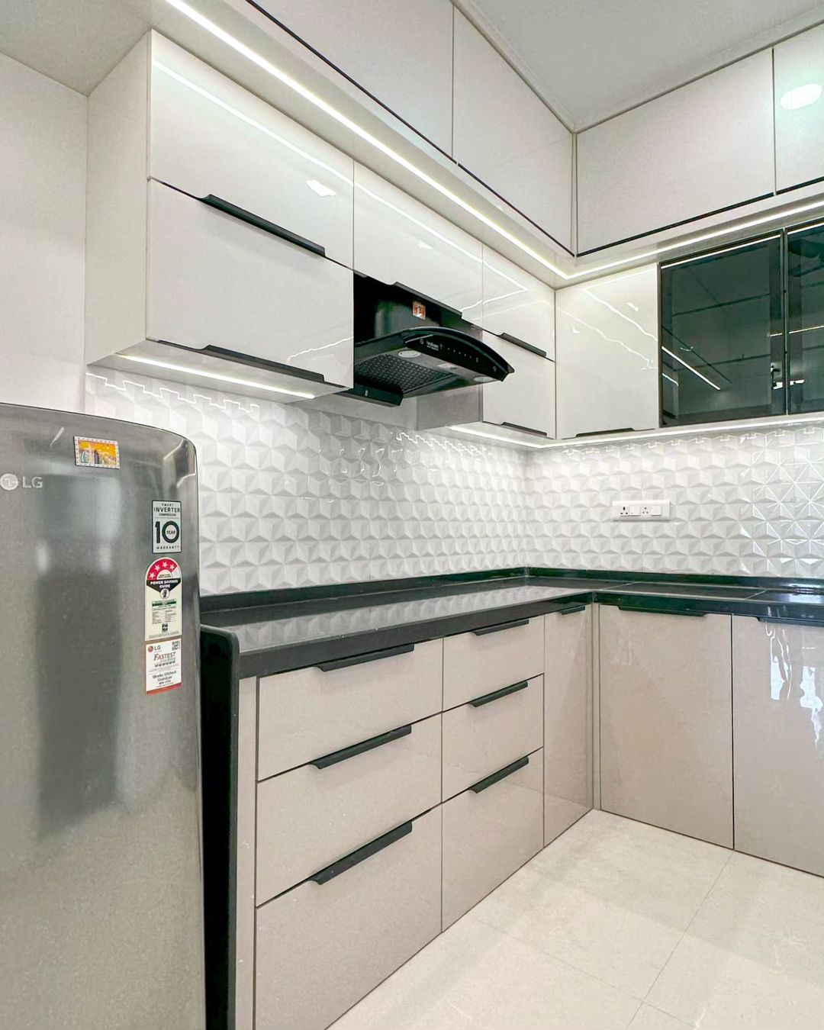
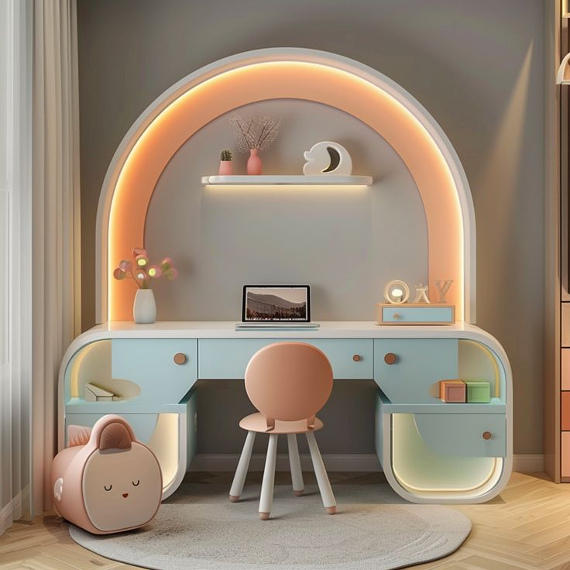
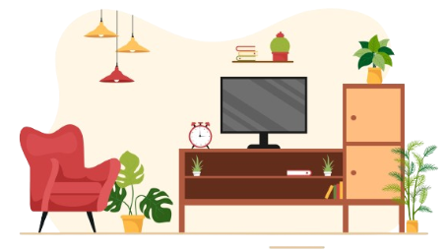
About Houzz Mood
Mission :- At Houzz Mood, we are your one-stop solution for all your home interior design needs. We specialize in modular Kitchen, Wardrobe & interior design, transforming your spaces into functional, modern, and adaptable environments that perfectly suit your lifestyle. Our mission is to create elegant spaces that blend seamlessly with your daily life, which is why we confidently offer our modular kitchen and wardrobe services.
Our goal is to provide unmatched service, paying close attention to every detail to ensure your complete satisfaction. Whether you’re starting a new project or looking to redesign your space, we’re here to help. We also excel in theme-based interiors that create a soothing ambiance. Our dedication and passion for crafting modular interiors make us the ideal choice for you. We elevate your space, adding a touch of class to your lifestyle. Connect with us today, and let’s create magical spaces together.
Crafting Unique and Stunning Transformations for Every Room.
A Beautiful and functional home is something everyone should enjoy, and HOUZZ MOOD Interior is passionate about helping you realize your vision. We have a wide array of products available, from trendy modular kitchens to all-encompassing interior solutions for both residential and commercial properties.

Slide 4
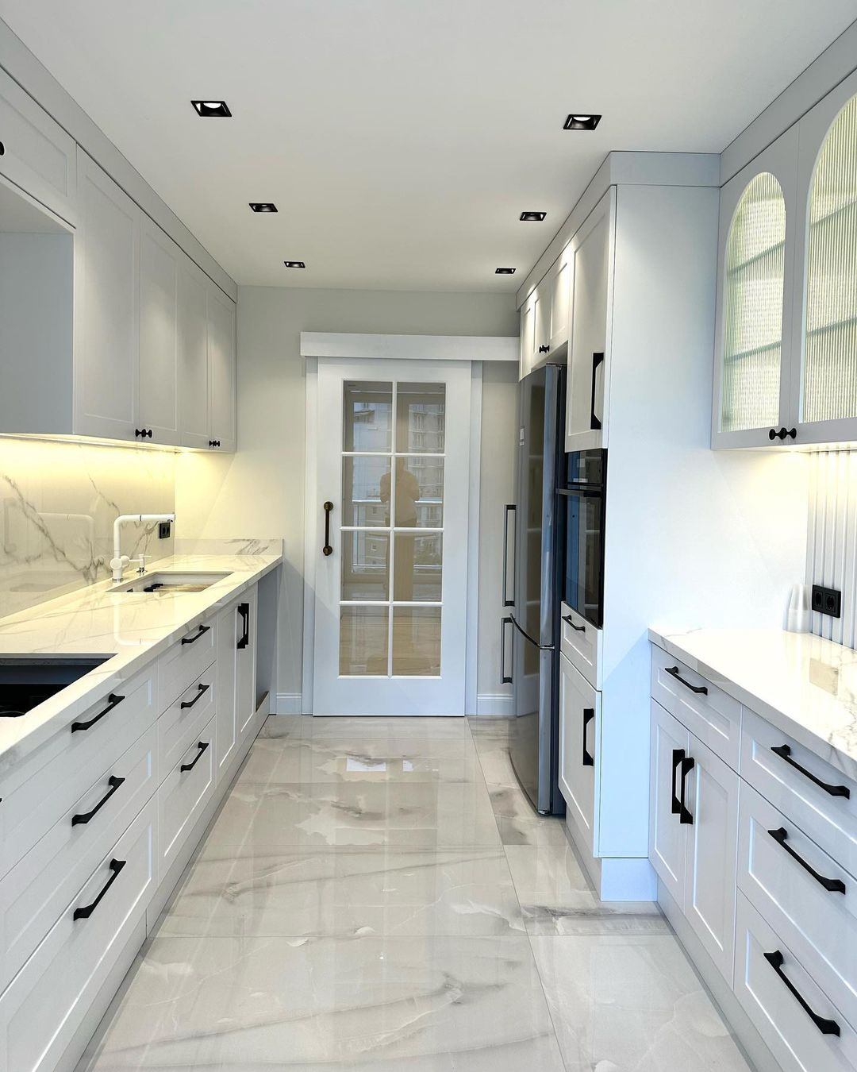
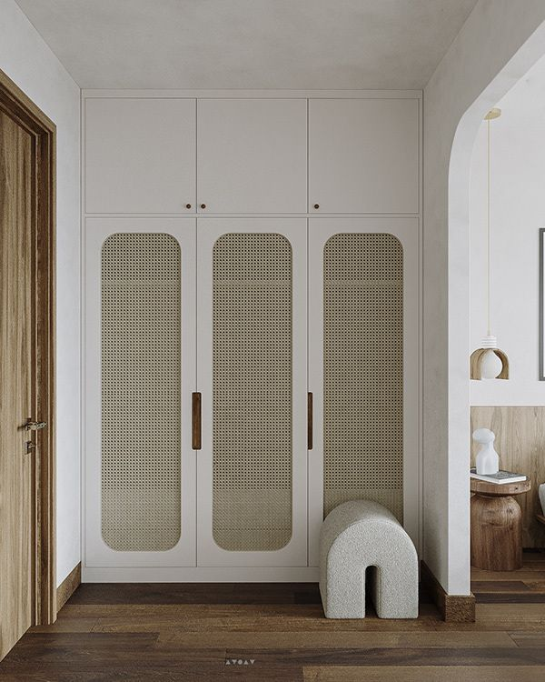
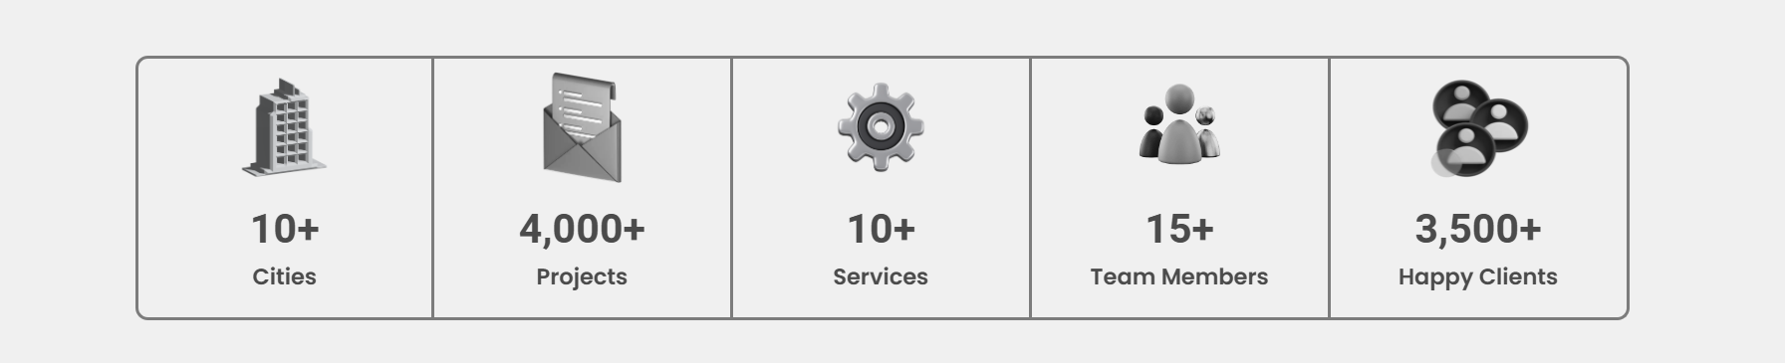
What makes us different :-
Best in Modular Kitchen & Wardrobe.
Completely Personalized On-time Project deliver.
Widest range of Product & finishes.
High-quality material.
Luxury Modular House Interior
Prompt after sales one-year free installation service on Site.
Lift Time Warranty Assured on Houzz Mood Product.

Slide 5




our company in a Glance
Our Vision :- (Houzz Mood vision is to create a world where everyone has access to affordable and functional modular furniture and quality Products that allows them to make a space that they love to live in).
Our Mission :- (Houzz Mood to deliver Modular Kitchen, interior design solutions, best quality Product and after sales Service that blend creativity with functionality, enhancing every space to meet the unique needs and aspirations of our clients).
Our Purpose :- (Our purpose is to deliver modular interiors that define your unique preferences and reflect functional, aesthetic and safe residential and commercial spaces for a better wellbeing.).

Slide 6
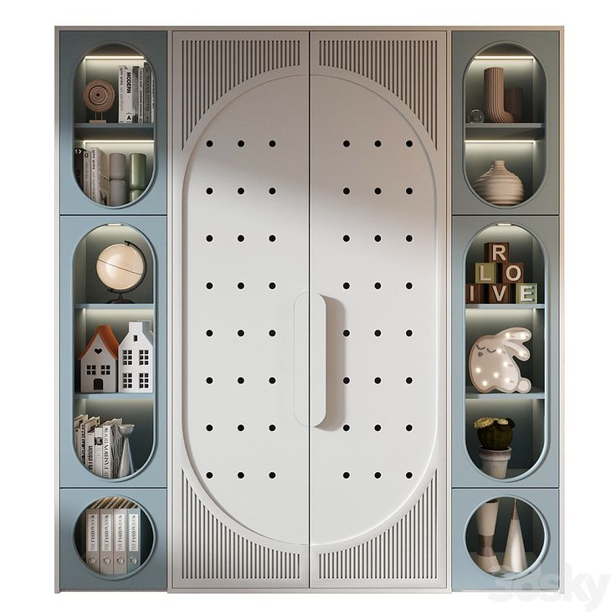
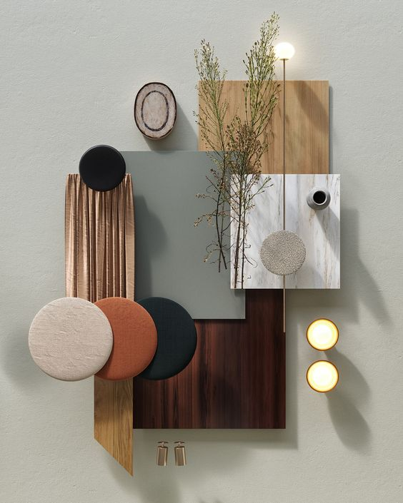
Our Service :-
Modular Kitchen, Wardrobe & Profile Door.
Modular Furniture (TV Unit, Bathroom Vanity, Crockery Unit, Study Table, Profile Shutter) Etc.
Full Home Interior Design in 2D and 3D Formats.
Office & Showroom Interior Design.
Architectural Consultancy.
Trunkey Projects.
Renovation.
Space Planning.
Post Project Completion.
Modular Hardware.

Slide 7


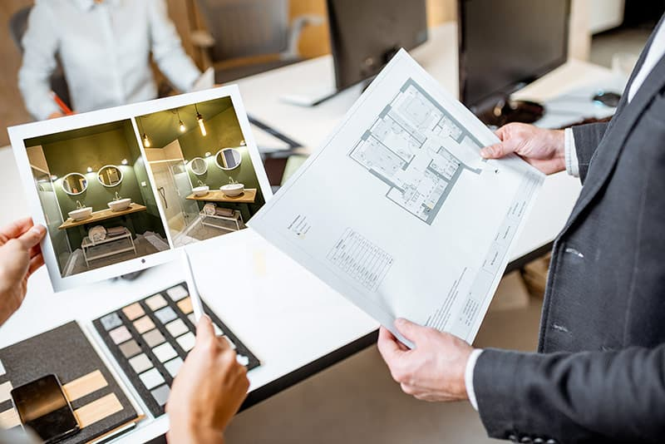


Why Hire Professional Designers?
Design is not just what it looks like and feels like. Design is how it Work. (Steve Jobe)
Avoiding Costly Mistakes.
Knowledge of Current Trends and Quality Brands.
Because you can’t invest as much time
Because we can make space more functional.
Because we have ample resources and the best contact just a call away.
Because we will offer you value for Money.
Because you'll still need a professional liaison.
Because we will give you best as per your budget.
Because we give creative ideas and stay to on trends.

Slide 8



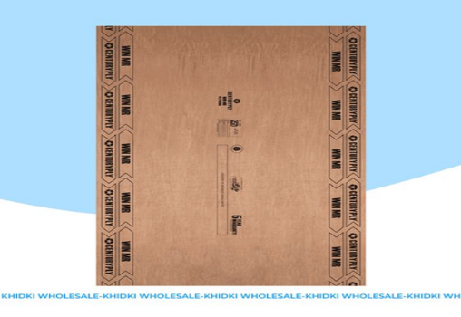
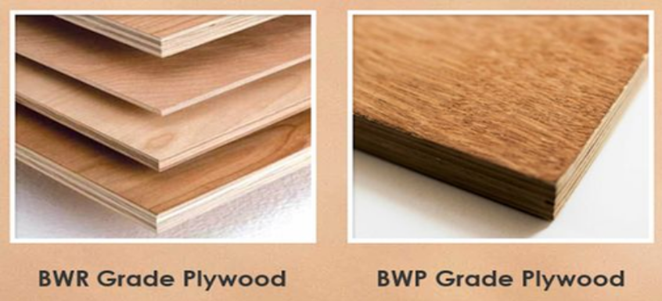
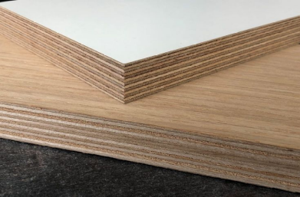


Houzz Mood Front Finish, Core Material & Hardware Brands we are dealing with
Front Finish
LAMINTE/ MICA:- MERINO, Advance, Century ETC.
ACRYLIC : - REHAU, DEXARATE ETC.
POLY-GLASS :- 2MM ACRYLIC.
P.U. SHUTTER :- PAINTED SHUTTER. Plain & Design.
VENEER & VENNER PU SHUTTER.
LACQUERED GLASS SHUTTER.
PROFILE SHUTTER :- Aluminum GLASS PROFILE SHUTTER.
LEATHER PROFILE SHUTTER.
U.V. SHUTTER (UL TRAVIOLET)
Hadware
1. Houzz Mood.
2. BLUM.
3. HAFELE.
4. Hettich.
Core Material
MR PLY: MOISTURE RESISTANT,
B.W.R. PLY: BOILLING WATER RESISTANCE
B.W.P. PLY: BOILING WATER PROOF
BIRCH PLY: RUSSIAN BIRCH
HDHMR: HIGH DENSITY HIGH MOISTURERESISTANCE
BOILO: BOILINGWATER PROOF BOARD
MR Ply
BWR PLY
BWP Ply
BRICH Ply
HDHMR
BOILO

Slide 9
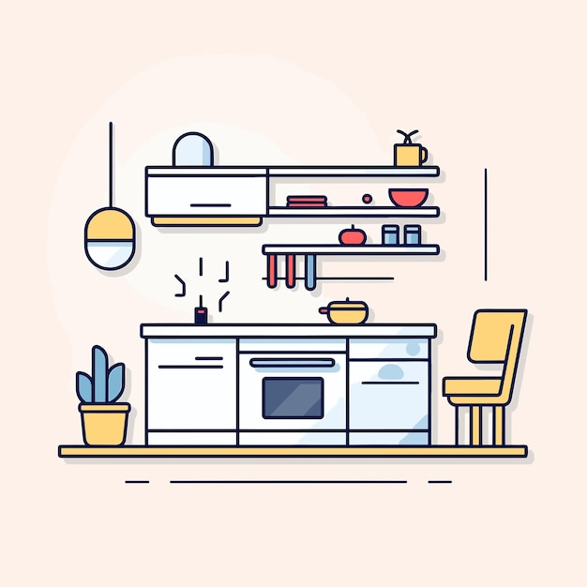



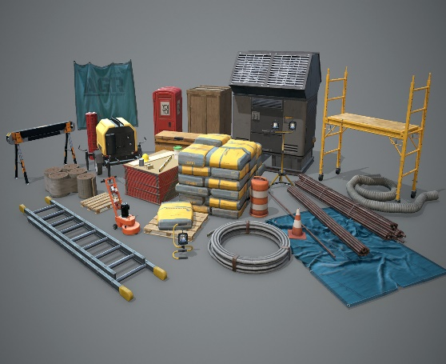
Hiring interior Designer :-
Phase 1 :-
Design & FEASIBLITY (This initial phase of the project includes preliminary studies of the site . We will find out more about you and your design ambitions for the project along with your timescales & budgets, We’ll work with you to build a detailed brief and identify your design preferences).
Phase 4 :-
Installation (While the project is ongoing we will work closely with the agencies to achieve the successful implementation of furniture design, Plumbing, electric flooring, & ceiling, along with the installation and completion of project).
Phase 2 :-
Technical & Supervision (Concept Design is the beginning of the creative process. We’ll develop architectural layouts for your property and decides finishes along with 3d of site. parallelize go through internal layouts and technical implementation of the design).
Phase 5 :-
Handover & Post PC (After project completion we will visit site to inspect all the works & prepare a schedule of defects if required and suggest remedies for the same or get things done by us if needed).
Phase 3 :-
Construction & production (We’ve completed the construction details design , the tender process begins. we work with our design team and finalize agencies for the project as per budget).

Slide 10
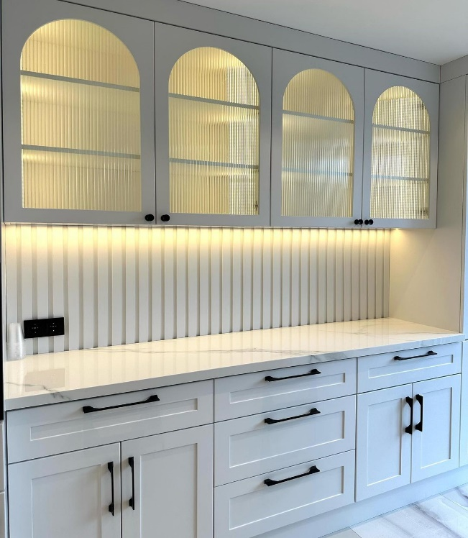
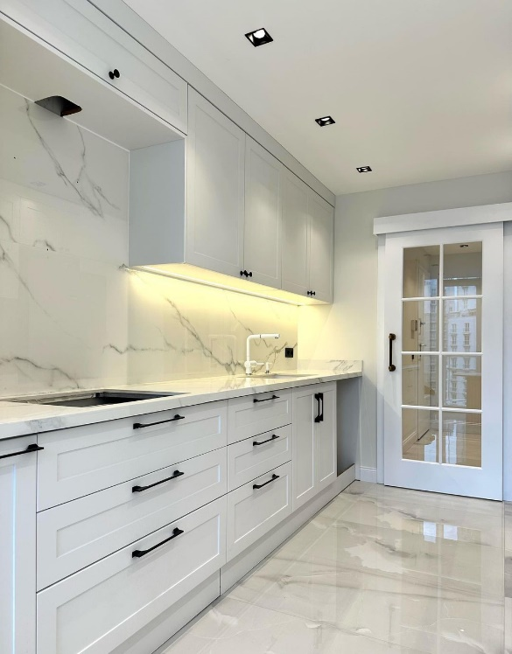

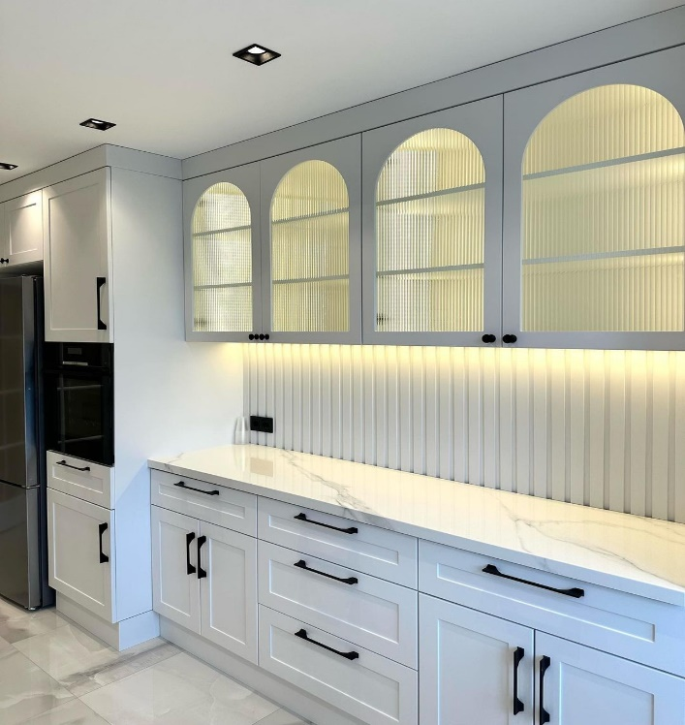
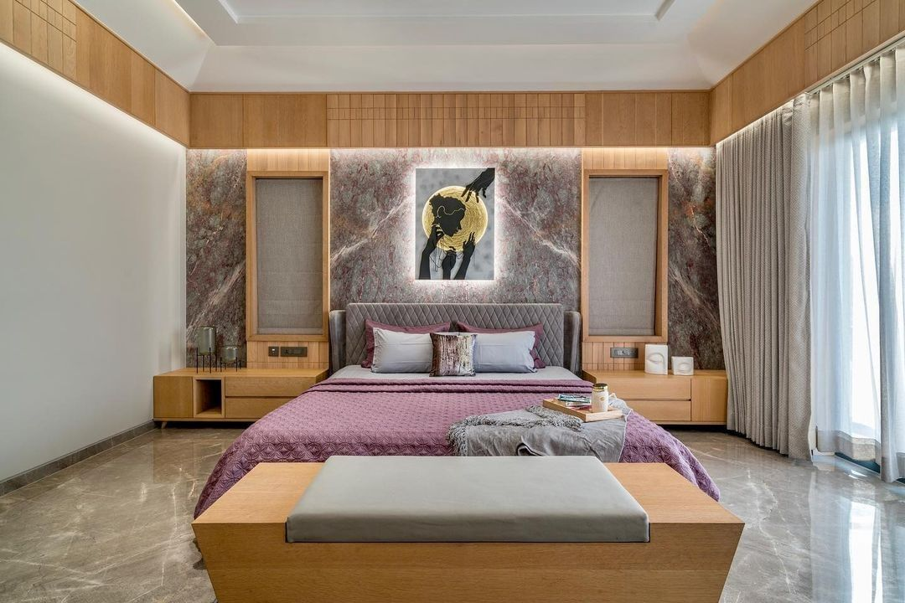
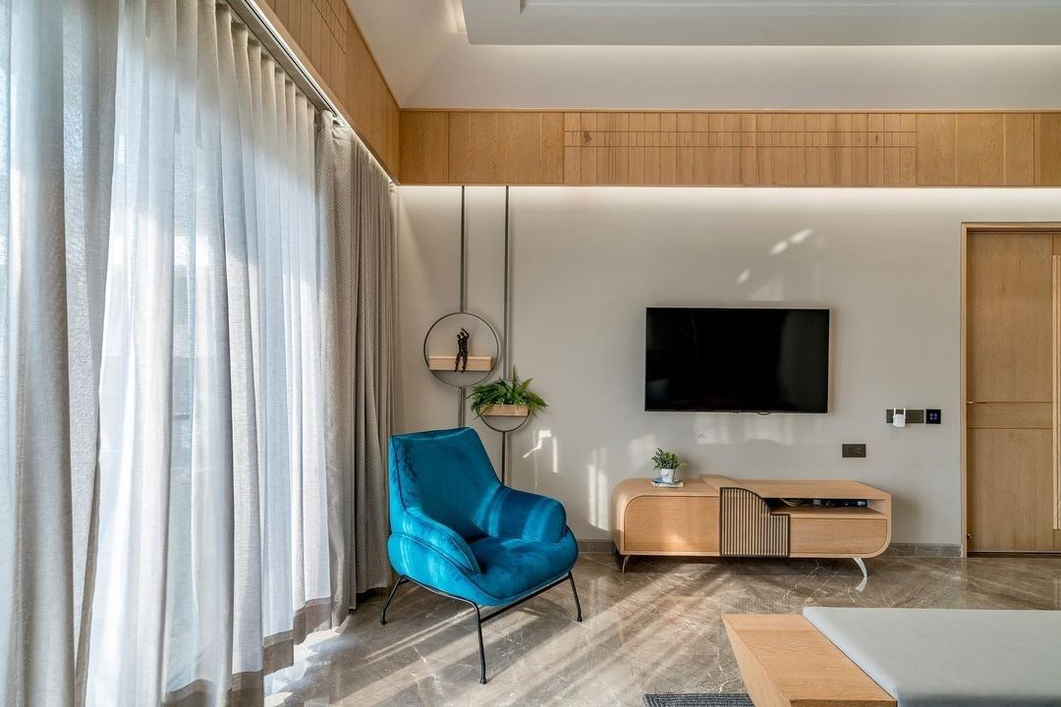
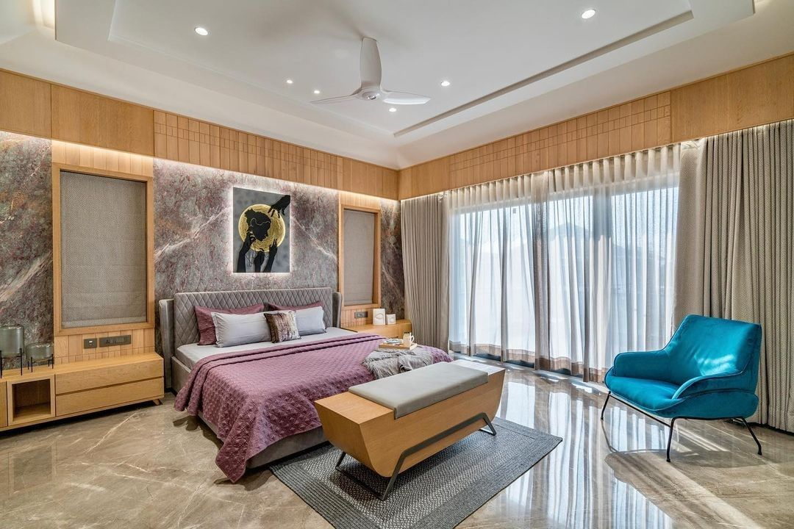
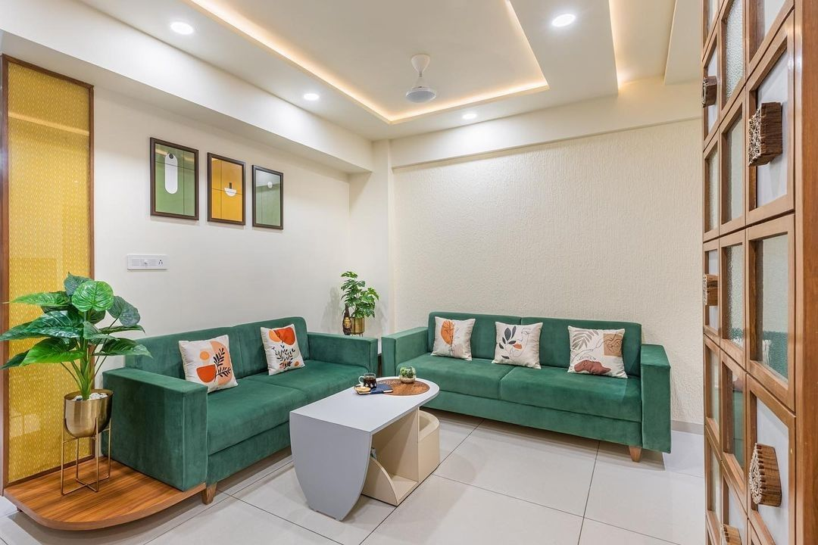
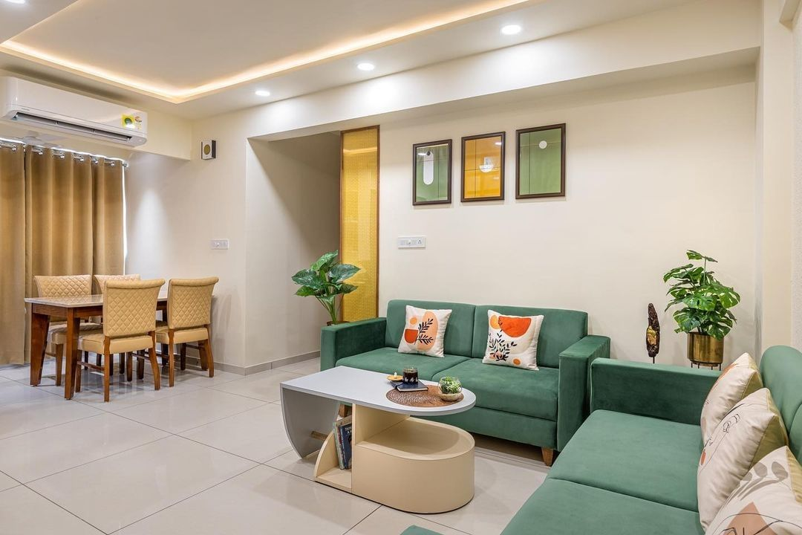
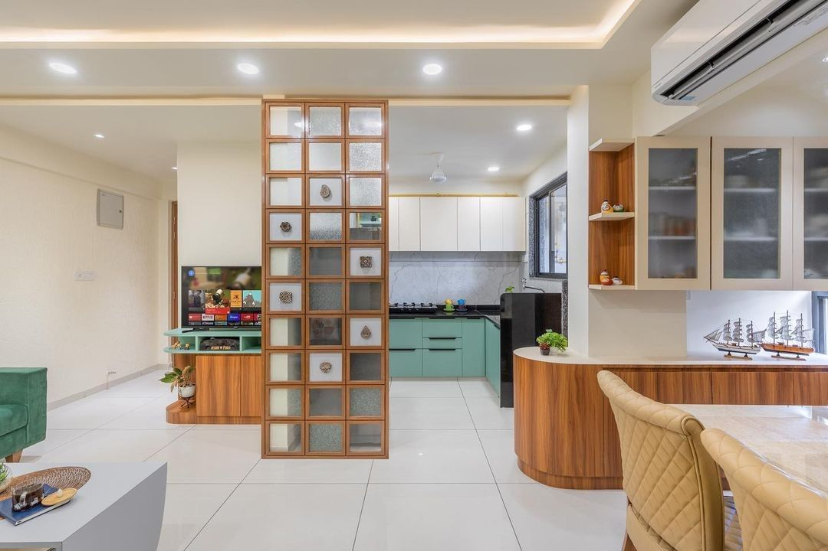
Glimpse of our work :-
Modular Kitchen & Wardrobe :-
"A kitchen has different flows and work areas that need to be integrated throughout that need of the user is fulfilled. A dining room is for consuming food so is usually adjacent to the kitchen for convenience in serving.
Bedroom :-
"Bedroom are private space which has to be designed as per the users need so they have to be personalized, this is where you spend time reading, relaxing, recharging & reflecting on the day .."
Living Room:-
“Living rooms are designed evolving, differently and because all users share the same space and purpose, to gather all in a comfortable space.."

Slide 11
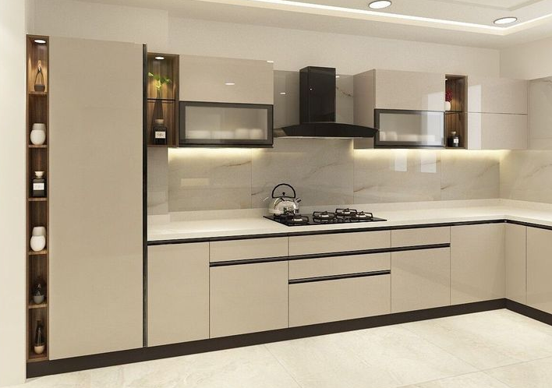
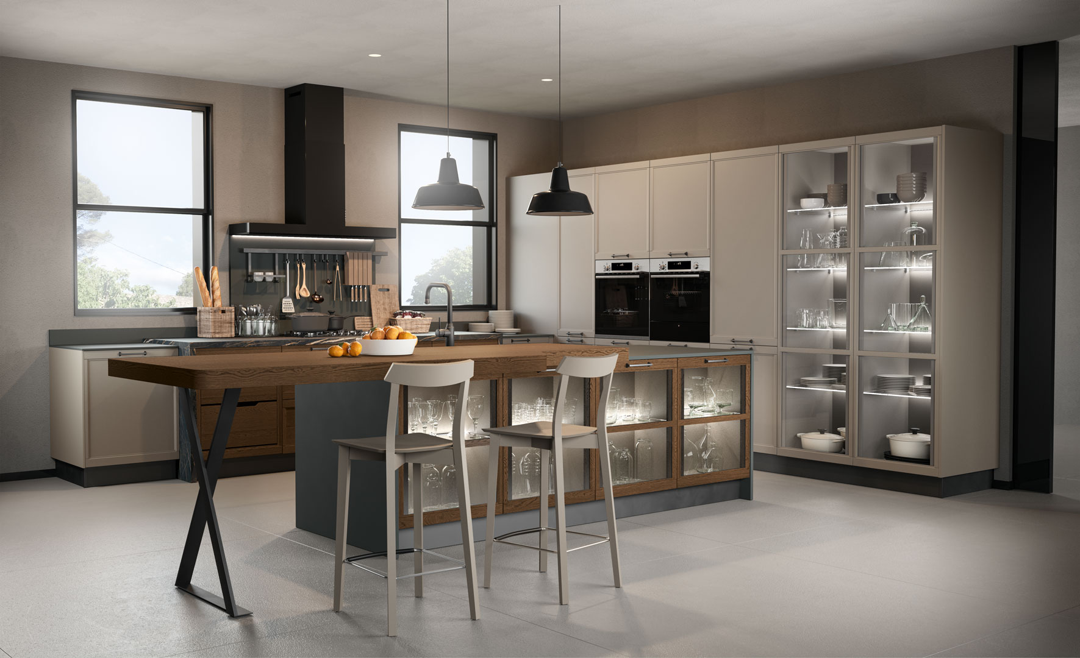
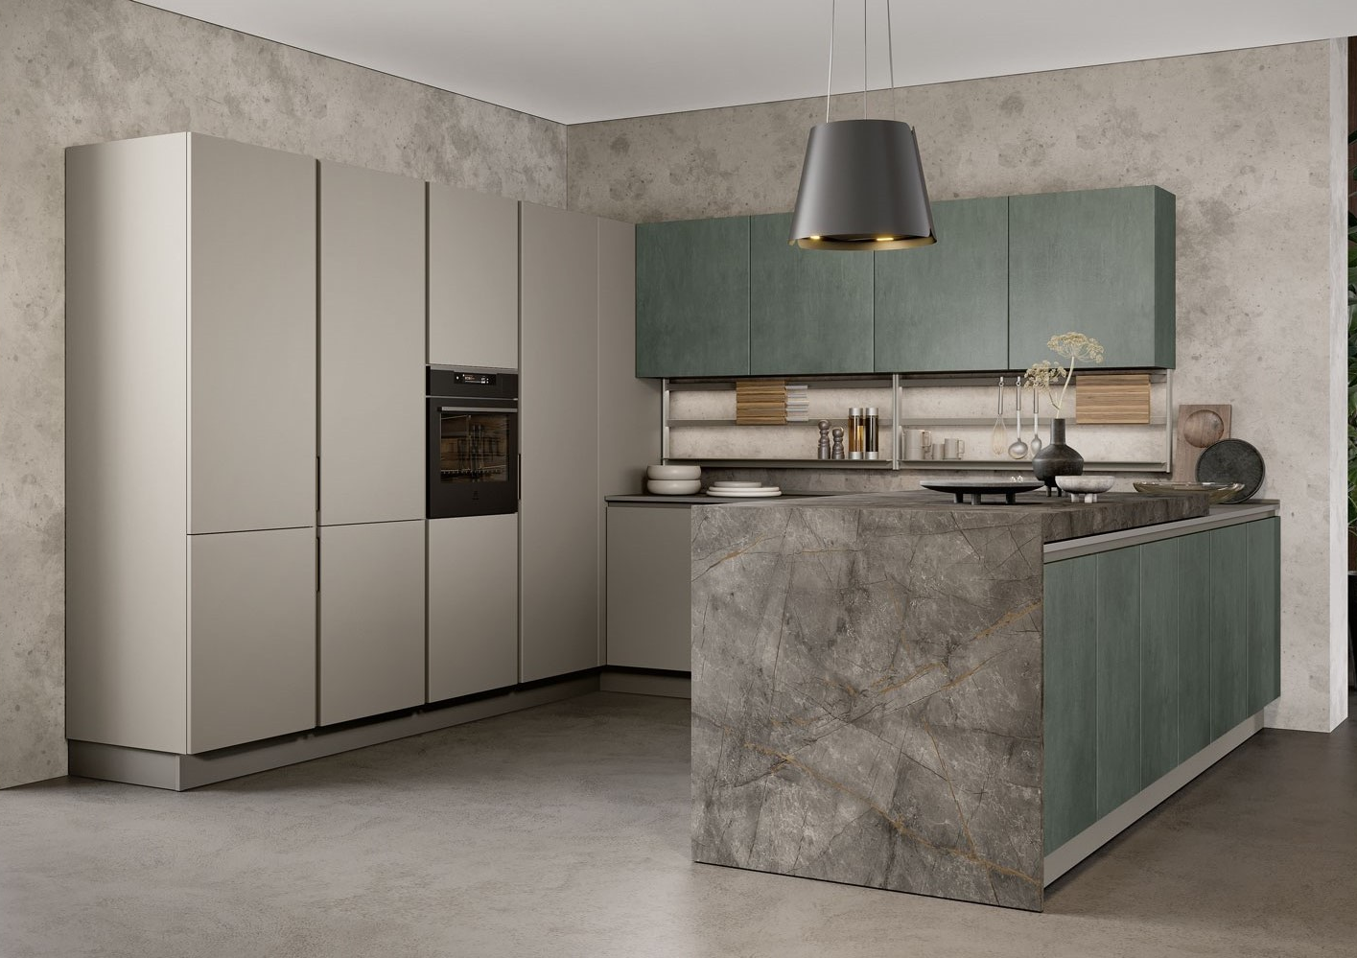
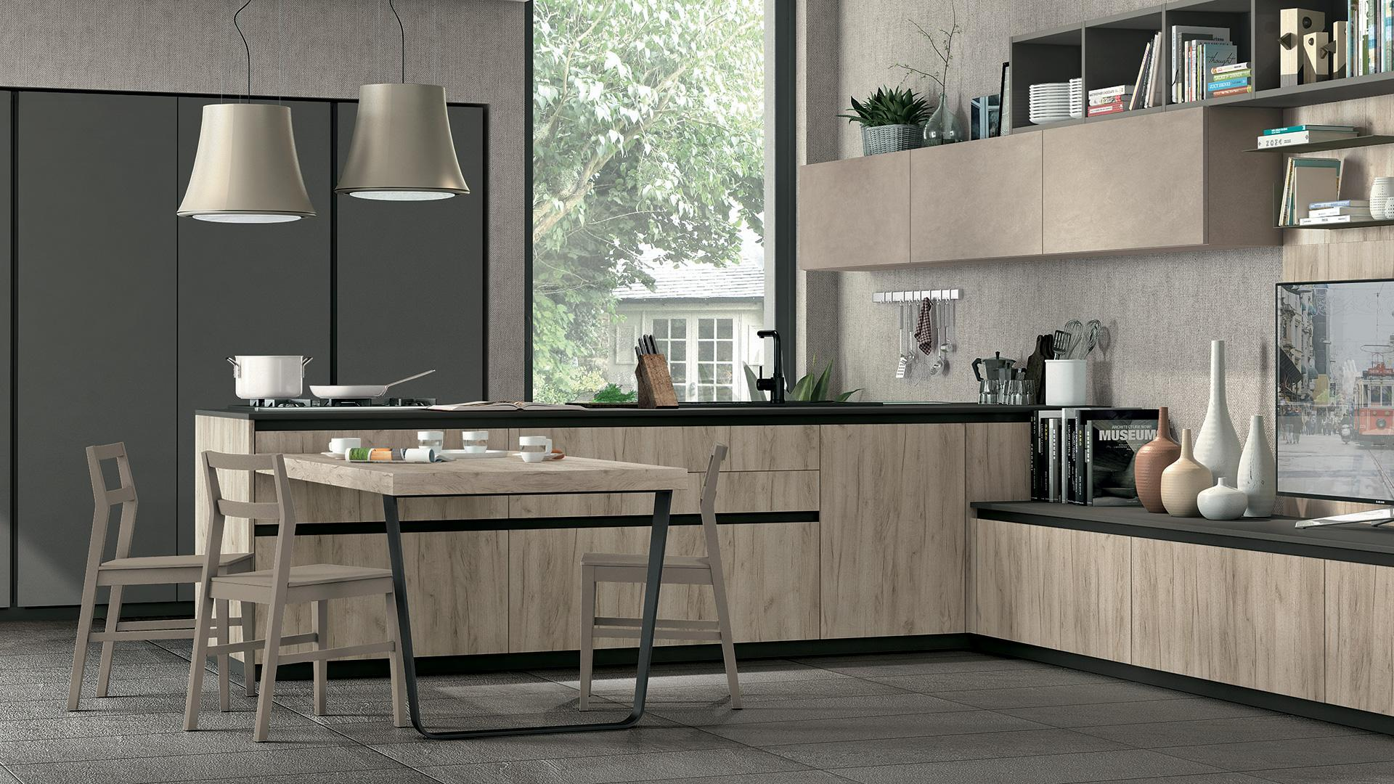
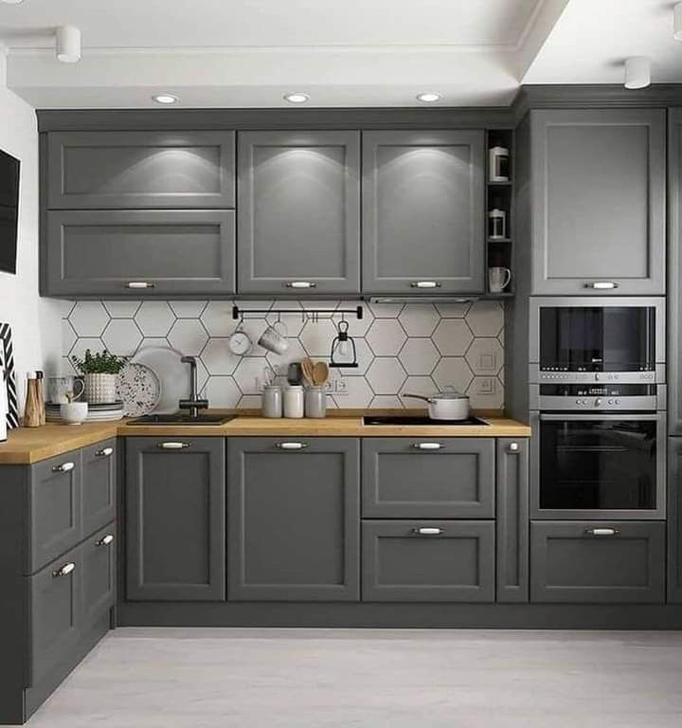
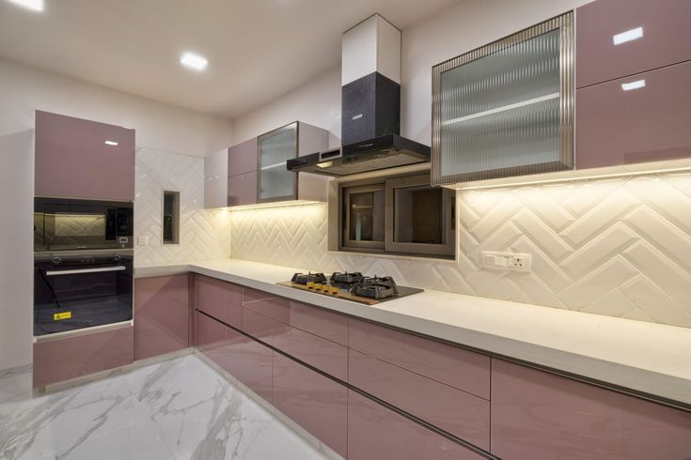
Modular Kitchen

Slide 12
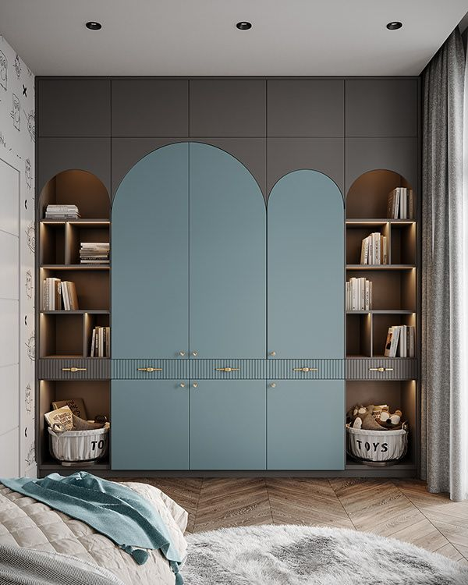
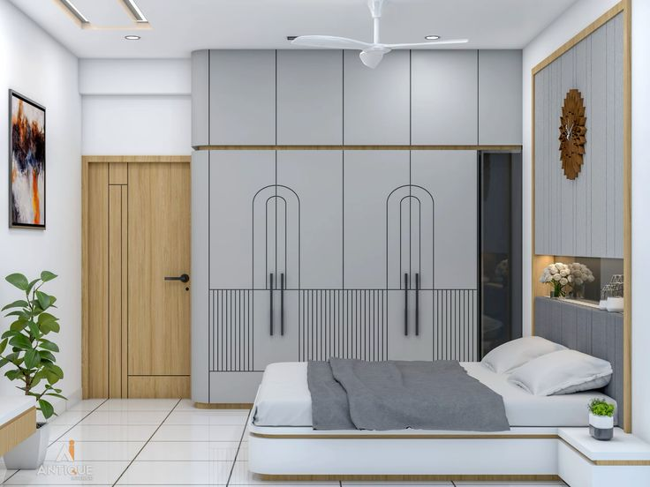
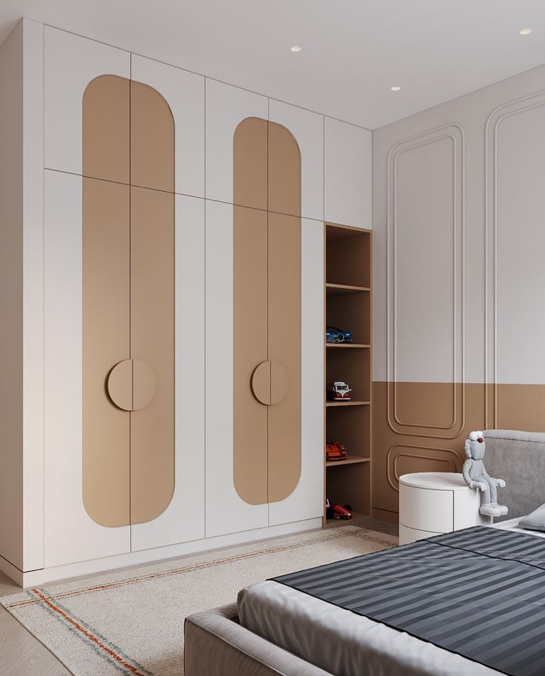
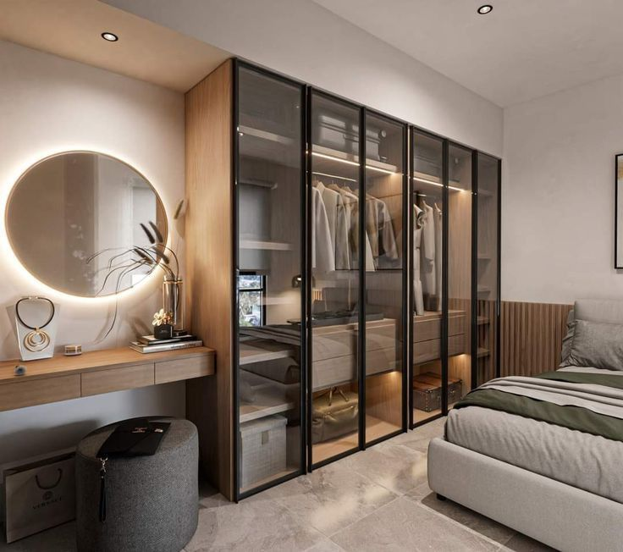
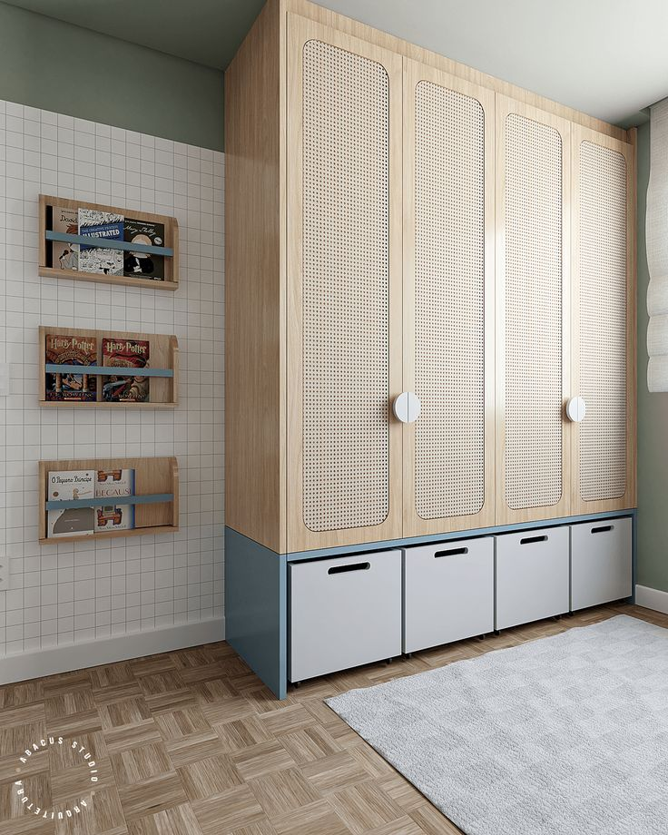
Modular Wardrobe

Slide 13
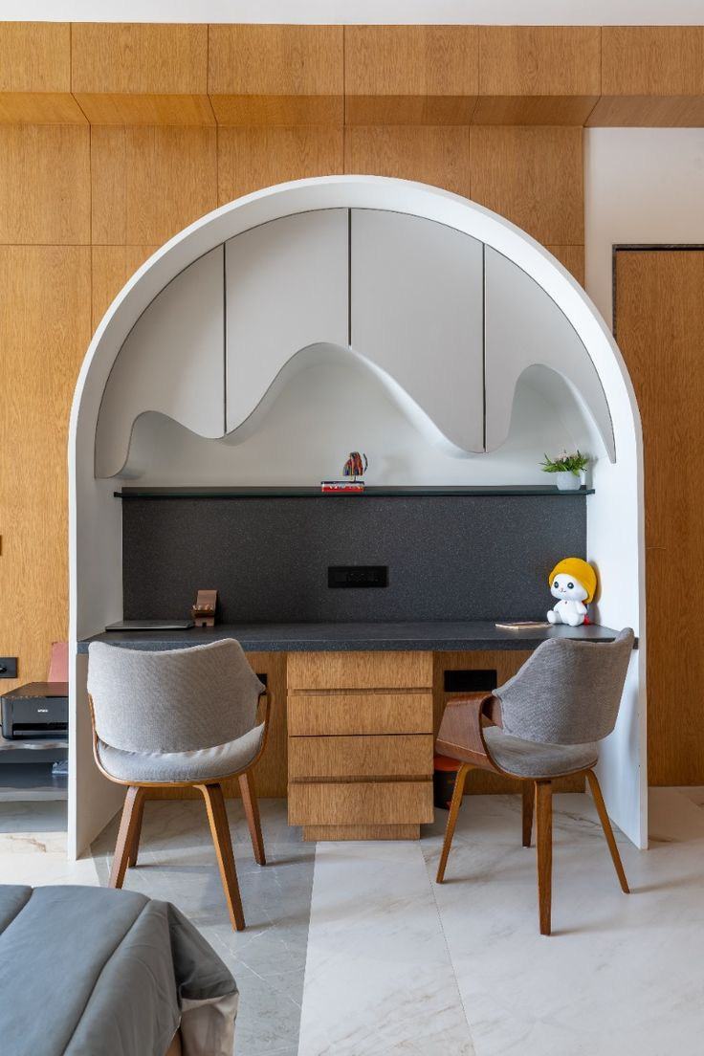
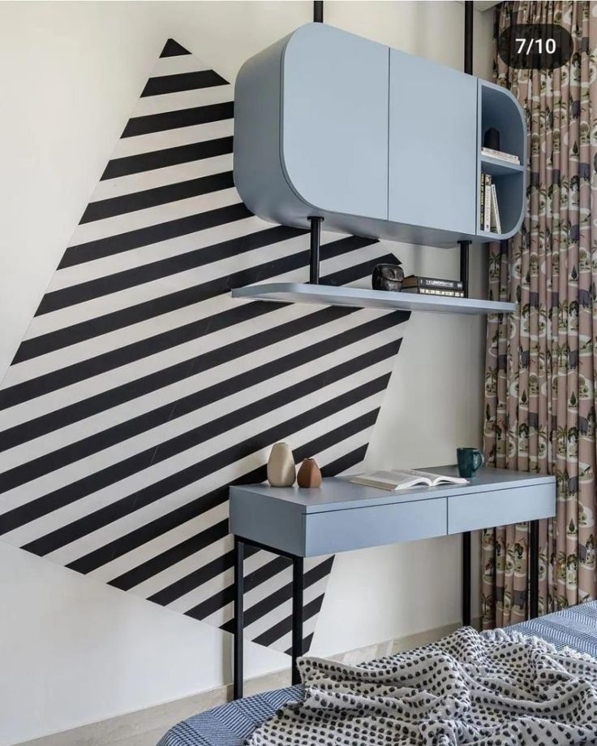
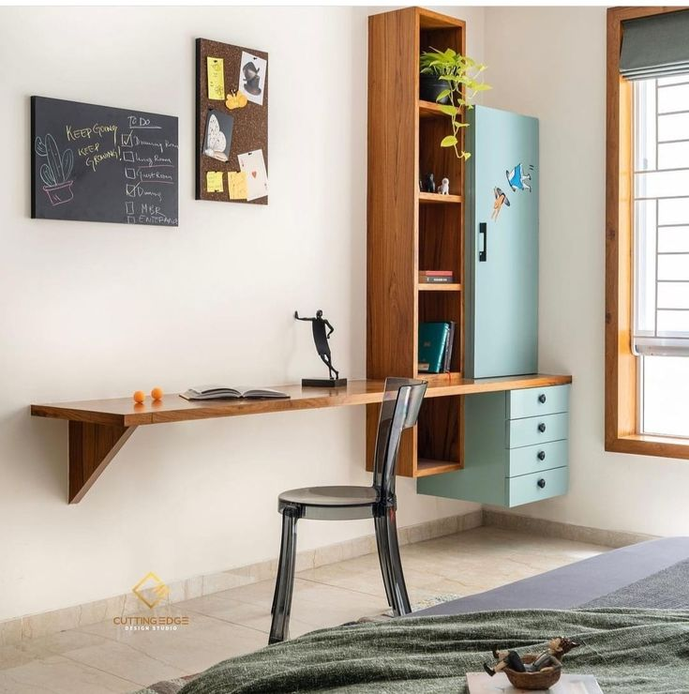
Modular Study Table

Slide 14
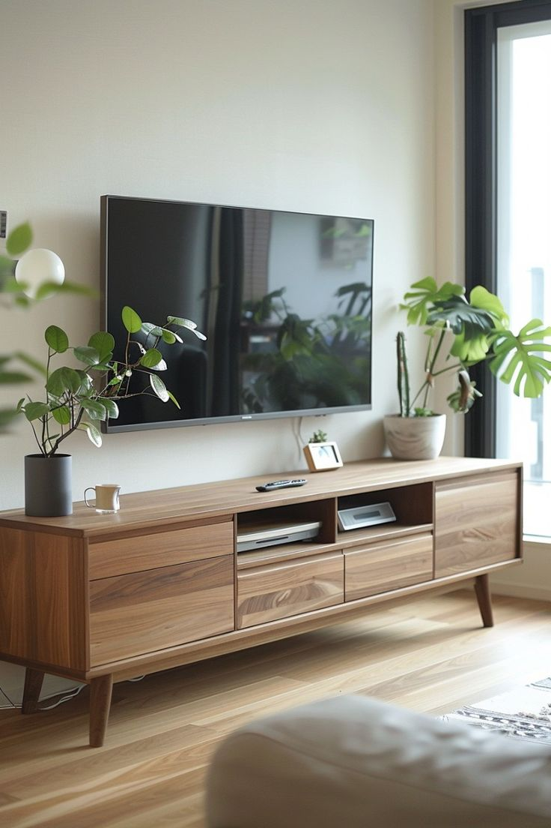
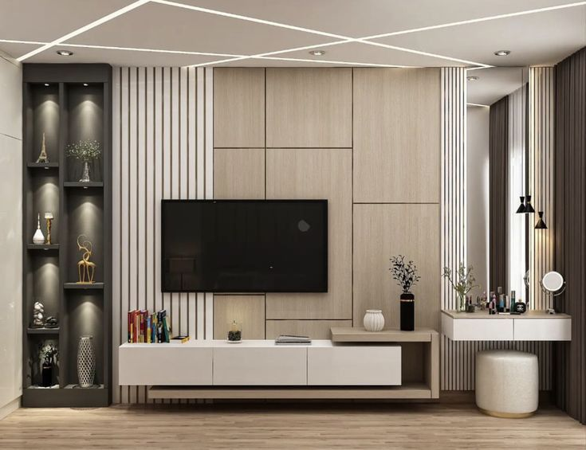
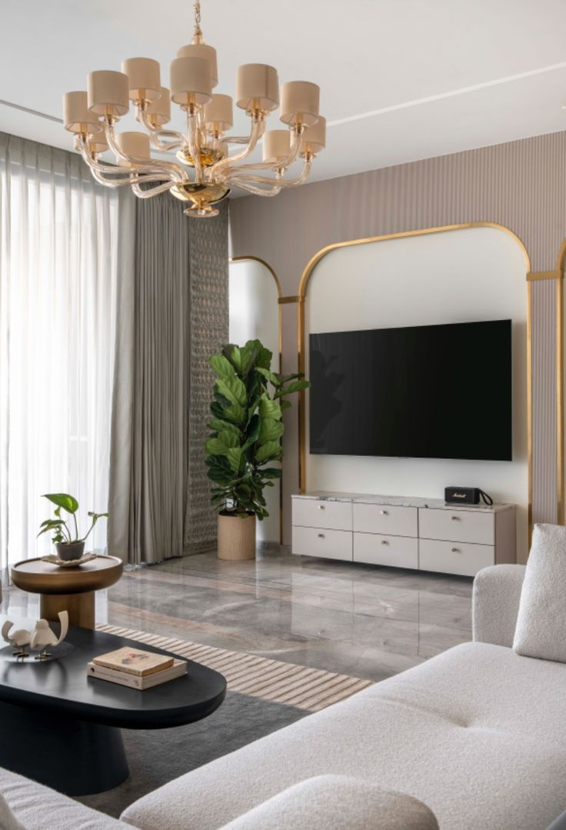
Modular TV Unit

Slide 15
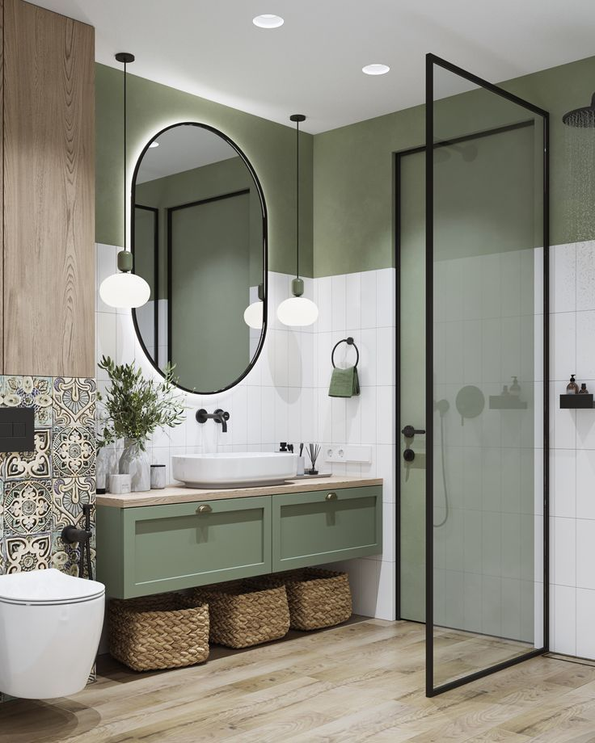
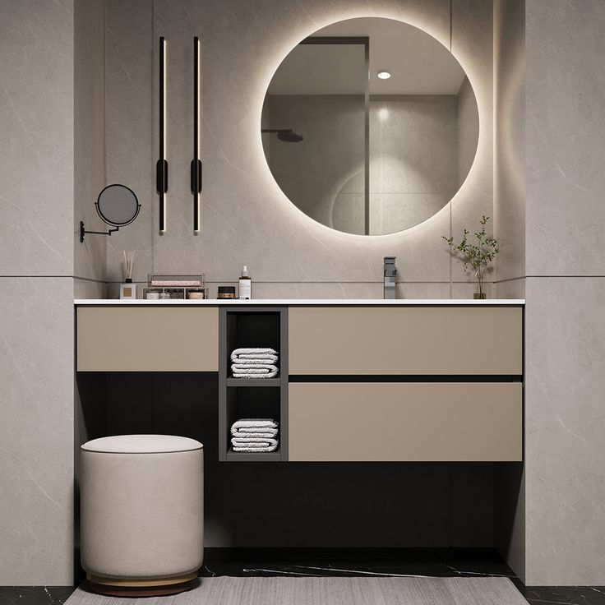
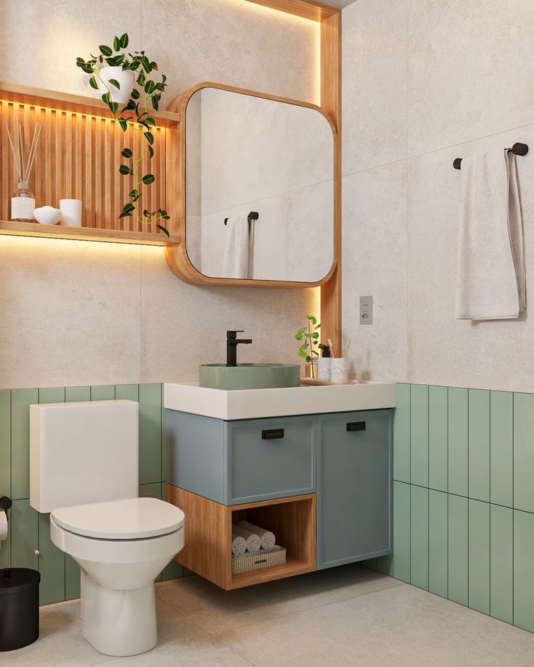
Modular Bathroom Vanity

Slide 16
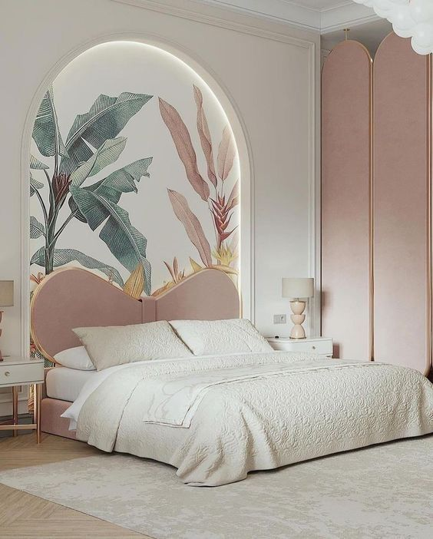
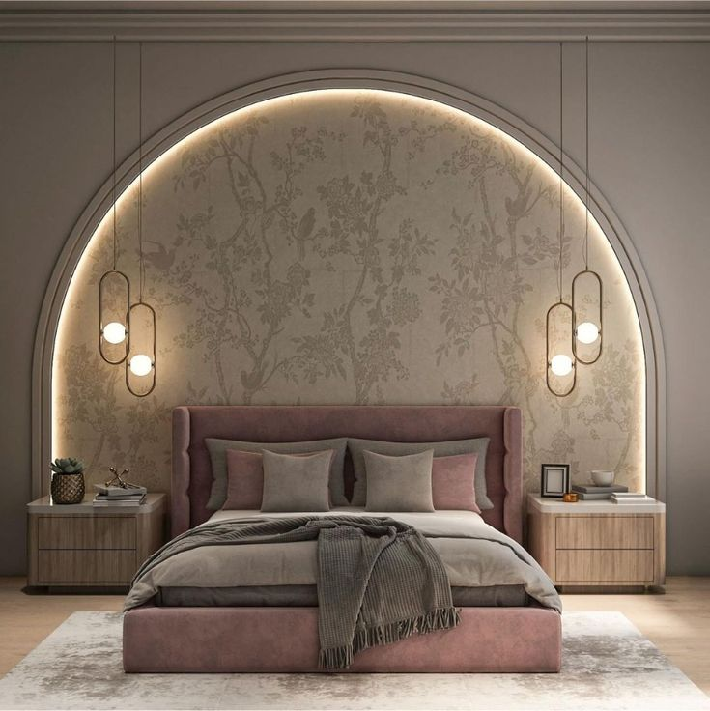







Modular Bedroom

Slide 17





Modular KIDs Bedroom

Slide 18





Living Area

Slide 19




Other Modular Furniture

Slide 20

Colour scheme Mood board

Slide 21







We can’t wait to create a space you can call home
Contact Details
Name :-Pawan Kumar Jangid
Mobile No :- +91 9549052999
Email :- info@houzzmood.com
Follow us :-
https://houzzmood.com.
https://www.instagram.com/houzzmood.
https://www.facebook.com/people/Houzzmood/61563673286660.

